Slide 1
Leigh Community Schools Public Feedback Meeting
July 9, 2018
Leigh High School Gymnasium

Slide 2
Introductions
Board Members
Jason Mullenhoff – President, Kamin Held – Vice President
Jill Becher – Treasurer, Ryan Hoffman, Julie McMullin
Stuart Osten, Josh Urban, Marcus Urban and Travis Went
April Brabec – Business Manager
Stephanie Petersen – Superintendent
Troy Holmberg – 7-12 Principal
Jeff Bachman and Justine Fischer – High School Teachers
Cody Hillen - DLR
Tobin Buchanan – First National Capital Markets

Slide 3
Why Are We Here?
The High School was built in 1907 with additions in 1920 and 1950.
We have urgent safety needs to address.
We want to share research and information on how these needs might be addressed.
The Board and Administration would like Community Feedback on a solution that everyone can support.
As a School Community, we are ALL responsible
to find a solution for our students.
Notes:
Jason – Board President

Slide 4
HOW DID WE GET HERE?
BOARD GOAL: District Buildings/Grounds/Transportation
I. Develop and maintain a working plan to support the maintenance and growth of district learning facilities, grounds, and transportation.
Jan. 2017: The Board and Administration worked with Educational Consulting Services to: Review the High School building, Develop preliminary programing information for the High School, and Discuss future planning concepts.
Sept. 2017: Annual Safety & Security Review showed: aging structure, no alternate fire exit on the third floor, inefficient boiler systems purchased in 1941 & 1987, not ADA compliant, loose gym tiles, and poor air quality.
Notes:
Jason – Board President

Slide 5
HOW DID WE GET HERE?
Jan. 2018 The Board hosted several Open Houses to allow the public to view the High School.
March 2018: Program Criteria Developer, DLR, completed facility assessments and identified program requirements.
July 2018: Public meeting held to discuss District needs and possible solutions.

Slide 6
URGENT NEEDS FACING THE HIGH SCHOOL BUILDING:
Notes:
Stephanie

Slide 7
HVAC REPLACEMENT NEEDED for Climate Control and Air Quality Inefficient Boiler System purchased in 1941 & 1987

Slide 8
Inefficient Boiler System purchased in 1941 & 1987

Slide 9
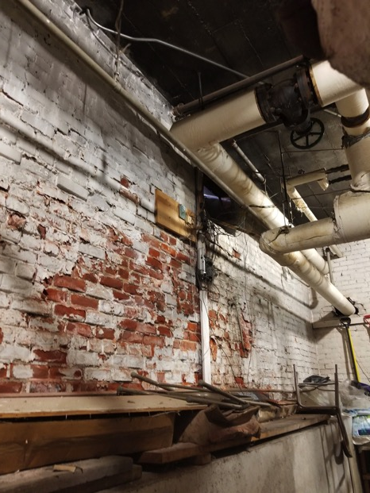

Slide 10
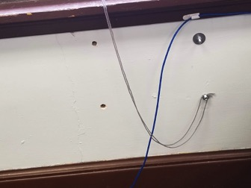
Fire Safety and Evacuation on 3rd Floor is Limited 2017 – Fire Ladders were purchased for the High School but structurally were not able to be installed due to safety standards

Slide 11
Lighting and Electrical are NOT Adequate

Slide 12
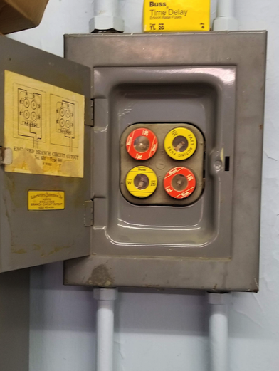

Slide 13
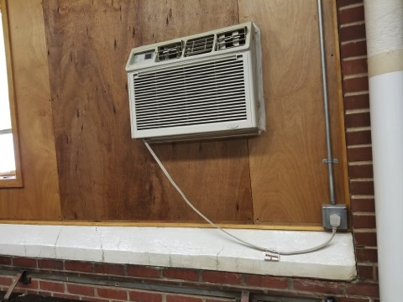
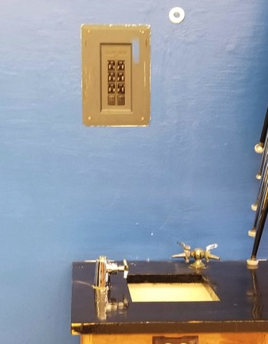
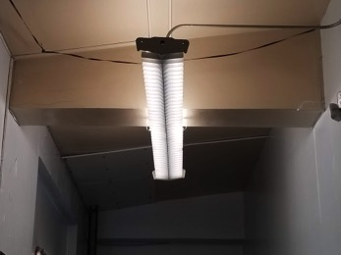

Slide 14
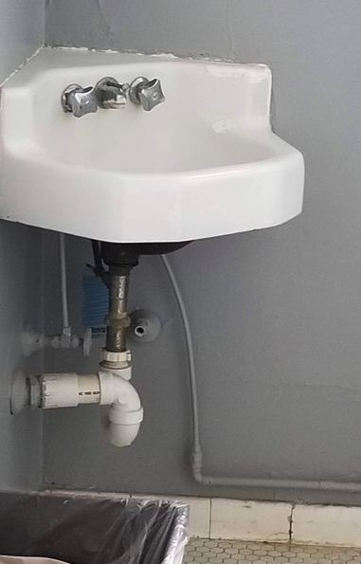
The Building is NOT ADA Accessible.

Slide 15
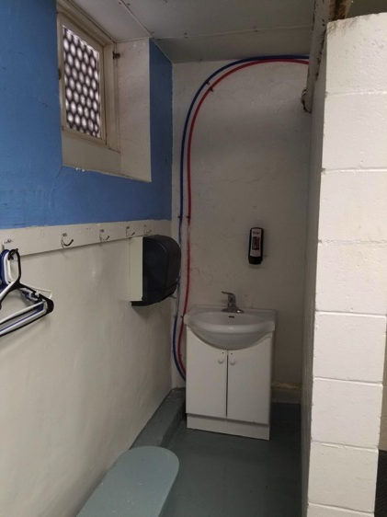

Slide 16
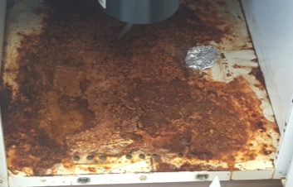
Inadequate and Outdated Classroom Sizes
Inside of cupboards:
Due to moisture

Slide 17
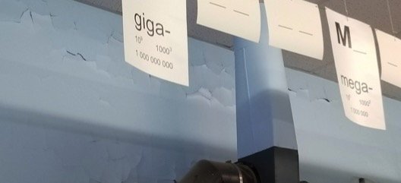
Deteriorating plaster and tile

Slide 18
Septic Tank Fumes and Odors in Classrooms

Slide 19
EDUCATIONAL AND COMMUNITY IMPACT OF POTENTIAL PROJECT
Accessibility for ALL Students and Patrons!
Safety and Security Upgrades Completed!
Classroom Designed for Present and Future Standards!
Adequate Classroom Space!
Programs to Meet the Needs of ALL Students!
Science, Fine Arts, Vocational Programs,
and Family Consumer Science
Climate Controlled Environment for Optimal Learning Conditions!
Adequate and Safe Parking!

Slide 20
EDUCATIONAL AND COMMUNITY IMPACT OF POTENTIAL PROJECT
Adequate Size Activity Space for both Curricular and Extra Curricular Programs
Opportunities for Community Use and Partnership of Building
Quality Facilities for the Present and Future Students of OUR Community
COMMUNITY AND DISTRICT PRIDE FOR LEIGH COMMUNITY SCHOOLS!

Slide 21
Current Facility & Site

Slide 22
Existing Floor Plan

Slide 23
Existing Site Plan

Slide 24
Option #1: Renovation and Remodel of Existing Facility

Slide 25
Option 1: Remodel

Slide 26
Option #2a: New Single Level High School Larger Gym and Weight Room

Slide 27
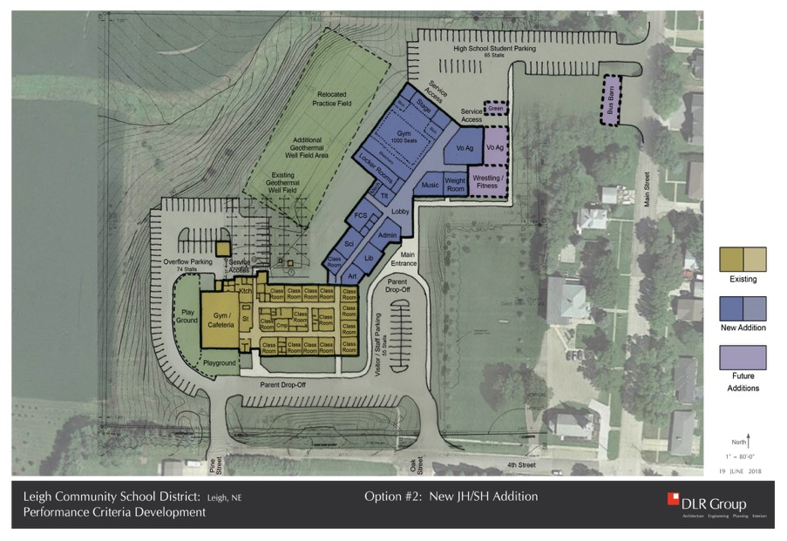
Option 2a: New Larger Gym & Weight Room

Slide 28
Option #2b: New Single Level High School Larger Gym and Weight Room with Possible Zion Property

Slide 29
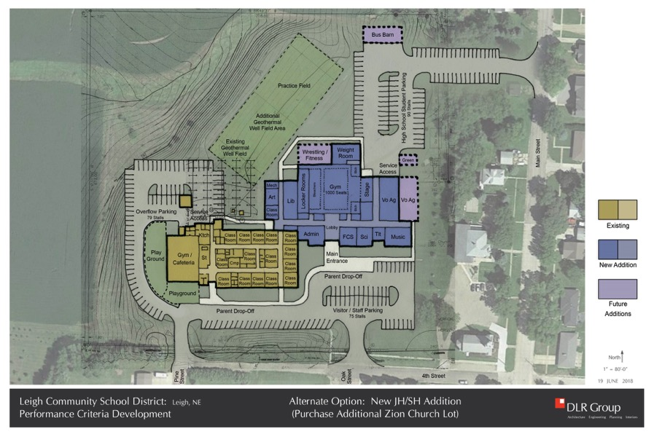
Option 2b: New Larger Gym & Weight Room with Possible Zion Property
Notes:
More room on site

Slide 30
Option #3: New Single Level High School Smaller Gym and No Weight Room

Slide 31
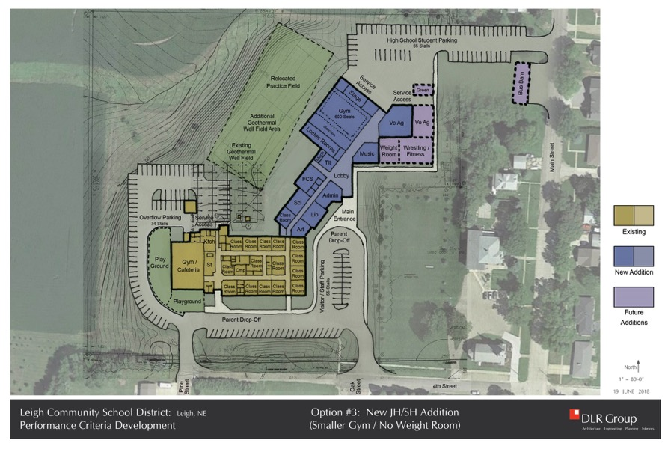
Option 3: New Smaller Gym No Weight Room

Slide 32
General Financial Information Fiscal Year 2017-2018
Current Valuation $468,830,424
Tax Revenue Per Cent Levied 46,883
Current General Fund Levy 0.600000
Current Building Fund Levy 0.135000
Total District Levy 0.735000
General Fund Tax Revenue $ 2,812,982
Building Fund Tax Revenue 632,921
Total Tax Revenue $ 3,445,903

Slide 33
17-18 Tax Levy Comparison of Selected School Districts

Slide 34
OPTION #1: Remodel Current Facility Estimate
Total Cost of Project $11,500,000
District Contribution 1,000,000
Par Amount of Bond Issue $10,500,000
Annual Levy For Debt Service 0.157000
General Building Bond Total
Current Levy 0.6000 0.1350 0.0000 0.7350
Levy w/Bond 0.6000 0.0100 0.1570 0.7670
Net Levy Impact of Option #1 0.0320

Slide 35
OPTION #2 NEW High School Addition Estimate
Total Cost of Project $10,800,000
District Contribution 1,000,000
Par Amount of Bond Issue $ 9,800,000
Annual Levy For Debt Service 0.147000
General Building Bond Total
Current Levy 0.6000 0.1350 0.0000 0.7350
Levy w/Bond 0.6000 0.0100 0.1470 0.7570
Net Levy Impact of Option #2 0.0220
Notes:
2B with an addition of Zion property

Slide 36
OPTION #3: NEW High School Addition Smaller Gym and No Weight Room Estimate
Total Cost of Project $ 9,300,000
District Contribution 1,000,000
Par Amount of Bond Issue 8,300,000
Annual Levy For Debt Service 0.125000
General Building Bond Total
Current Levy 0.6000 0.1350 0.0000 0.7350
Levy w/Bond 0.6000 0.0100 0.1250 0.7350
Net Levy Impact of Option #3 0.0000

Slide 37
Option #1 Tax Payer Impact
NET levy impact of 3.20 cents for district tax payer
Homeowner Tax Impact Ag Land Tax Impact
$ 50,000 $16.00 Irrigated Quarter $307.00
$100,000 $32.00 Dryland Quarter $270.00
$150,000 $48.00 Grassland Quarter $106.00
$200,000 $64.00
*Average assessed value per acre provided by Colfax County Assessor:
Irrigated Acre $5,980 Quarter $956,800
Dryland Acre $5,265 Quarter $842,400
Grassland Acre $2,055 Quarter $328,800
Annual individual tax payer impact = Total Valuation x .00032

Slide 38
Option #2 Tax Payer Impact
NET levy impact of 2.20 cents for district tax payer
Homeowner Tax Impact Ag Land Tax Impact
$ 50,000 $11.00 Irrigated Quarter $211.00
$100,000 $22.00 Dryland Quarter $186.00
$150,000 $33.00 Grassland Quarter $ 73.00
$200,000 $44.00
*Average assessed value per acre provided by Colfax County Assessor:
Irrigated Acre $5,980 Quarter $956,800
Dryland Acre $5,265 Quarter $842,400
Grassland Acre $2,055 Quarter $328,800
Annual individual tax payer impact = Total Valuation x .00022

Slide 39
Option #3 Tax Payer Impact
NET levy impact of 0.00 cents for district tax payer
Homeowner Tax Impact Ag Land Tax Impact
$ 50,000 $0.00 Irrigated Quarter $0.00
$100,000 $0.00 Dryland Quarter $0.00
$150,000 $0.00 Grassland Quarter $0.00
$200,000 $0.00
*Average assessed value per acre provided by Colfax County Assessor:
Irrigated Acre $5,980 Quarter $956,800
Dryland Acre $5,265 Quarter $842,400
Grassland Acre $2,055 Quarter $328,800
Annual individual tax payer impact = No Net Tax Payer Impact

Slide 40
Consolidation Scenario
District Gen Fund Valuation Tax Request
Leigh 0.6000 $468,830,424 $2,812,982
Clarkson 0.7346 $406,082,875 $2,983,158
Combined 0.6634 $874,923,299 $5,796,040
Net increase of 6.634 cents for Leigh Community Schools
Scenario only considers general fund/operational impact
Merged districts could also have facility improvement needs that would require bond issue or building fund levy increase

Slide 41
OUR SCHOOL-OUR COMMUNITY
Place student needs at the front of all decisions
Provide a safe and secure learning environment for the children in our community
Pursue academic excellence in all areas of our curriculum for all students
Create a foundation of student success now and in the future
Invest in the long term sustainability of our
District and Community
Have informed discussion and feedback on the merits of the solution
Notes:
Jason - Board President

Slide 42
Comments Questions Survey Tour of the Building

